Slide 1
Introduction in CSS3

Slide 2
Agenda
CSS3
What’s new
Browser support
Pseudo classes
Box Model
Columns
Rounded Corners
Box & Text Shadow
Calc()
Animations | Transitions
Media Queries
Responsive | Adaptive
Mobile or Desktop first

Slide 3

CSS3

Slide 4
CSS3
What’s new
What’s different from the previous version?
Each module either describes the newer capabilities or changes to the previous specification. One key point here is that backwards compatibility is preserved.
As a result of breaking down the specification into smaller pieces, each module is in a distinct state of readiness.
There are over 50 CSS modules that are in various states of readiness.
NEWS: Borders, Backgrounds, Color, Text effects, User-interface, Selectors, Basic box model, Generated Content, CSS3 Transitions
Media queries, Multi-column layout, Web fonts …

Slide 5
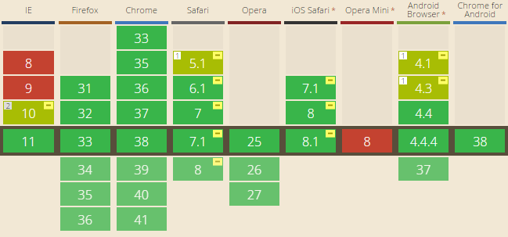
CSS3
Browser support

Slide 6
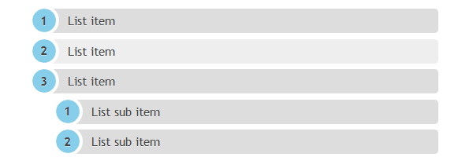
CSS3
Pseudo classes
match elements based on criteria other than tags, IDs or classes
selectors look like :selector_name and there are several types:
:nth-child(N) - matches elements on the basis of their positions within a parent element’s list of child elements
:nth-last-child(N) - matches elements on the basis of their positions within a parent element’s list of child elements
:nth-of-type(N) - matches elements on the basis of their positions within a parent element’s list of child elements of the same type
:nth-last-of-type(N) - matches elements on the basis of their positions within a parent element’s list of child elements of the same type
DEMO

Slide 7
CSS3
Pseudo classes
:first-of-type - matches the first child element of the specified element type
:last-of-type - matches the last child element of the specified element type
:only-child - matches an element if it’s the only child element of its parent
:only-of-type - matches an element that’s the only child element of its type
:root - matches the element that’s the root element of the document
DEMO

Slide 8

CSS3
Pseudo classes
Negation pseudo-class
:not(X)
X = selector
:not(:visited) { }
Chaining :not selectors with other :not selectors is permissible.
<style type=”text/css”>
article {
background: black;
}
article:not(.A):not(.B) {
background : red;
}
</style>
DEMO

Slide 9

CSS3
Pseudo classes
Matching attributes selectors
:contains()
[att^=val] – the “begins with” selector
[att$=val] – the “ends with” selector
[att*=val] – the “contains” selector
DEMO

Slide 10
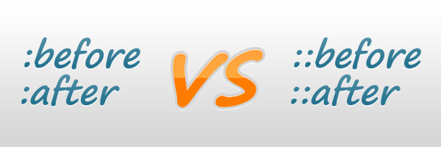
CSS3
Pseudo classes
Generated content
:: There is absolutely no difference between :before and ::before, or between :after and::after. Using double colon for pseudo-elements is “the new thing”, the CSS3 way.
<style type=”text/css”>
div::before{
content: “Read this- ”;
color: red;
}
div::after{
content: “-stop here!”;
color: green;
}
</style>
DEMO

Slide 11
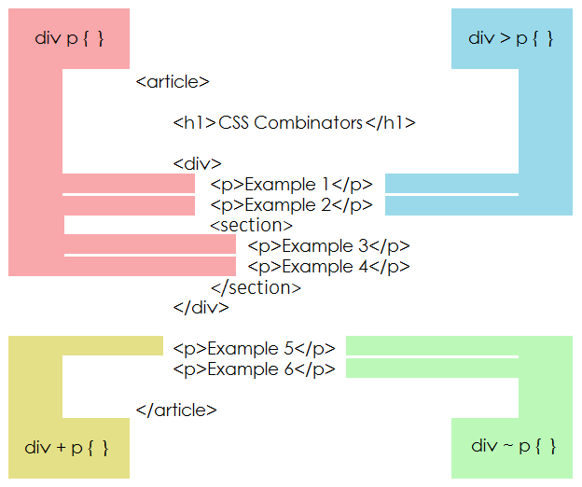
CSS3
Pseudo classes
Combinators
Siblings combinators
div + p
div ~ p
Descendant combinators
div > p
DEMO

Slide 12
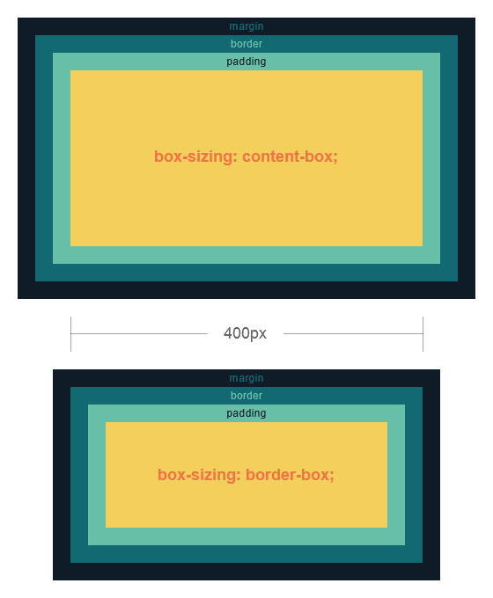

CSS3
Box Model
.content{
box-sizing: content-box;
width: 400px;
padding: 15px;
border: 25px solid lightpink;
}
Total width: 400px+(15px*2)+(25px*2)=480px;
.content{
box-sizing: border-box;
width: 400px;
padding: 15px;
border: 25px solid lightpink;
}
Total width: 400px;
DEMO

Slide 13
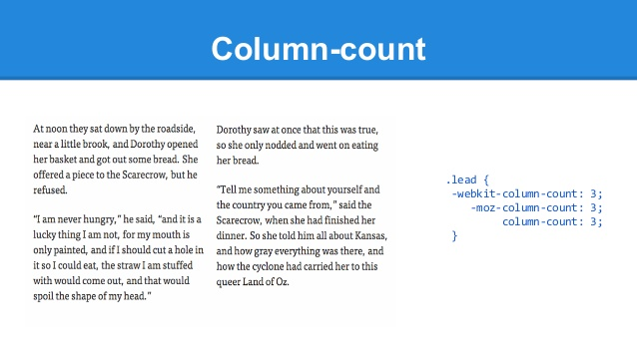
CSS3
Columns
Where to declare columns?
You can declare columns on any block level element. Columns can be applied to a single element or applied to multiple elements by targeting their parent.
How to declare columns?
Declare column-count.
Declare column-width.
Declare both (recommended).
DEMO

Slide 14

CSS3
Rounded corners
The CSS3 border-radius property allows web developers to easily utilise rounder corners in their design elements, without the need for corner images or the use of multiple div tags, and is perhaps one of the most talked about aspects of CSS3.
EX:
border-top-left-radius: 10px 5px; border-bottom-right-radius: 10% 5%; border-top-right-radius: 10px;
DEMO

Slide 15

CSS3
Box & Text shadow
Text shadow
Syntax
text-shadow: horizontal-offset vertical-offset blur color;
Box Shadow
Syntax
box-shadow: horizontal-offset vertical-offset blur color;
DEMO

Slide 16

CSS3
Calc()
Use 1:
body{ width: calc(100% - 50px);
height: calc(85% + 10px); }
Use 2:
.icon{
background-image: url(‘logo.png'); background-position: calc(100% - 25px) calc(100% - 25px;) }

Slide 17
CSS3
Calc()
Use 3 grids:
.column-1-7{
width: 14.2857%; } .column-3-7{
width: 42.8571%; }
.column-1-7{
width: calc(100% / 7); } .column-3-7{
width: calc(100% / 3); }
DEMO

Slide 18

CSS3
Animations | Transitions
With CSS3 transitions you have the potential to alter the appearance and behavior of an element whenever a state change occurs, such as when it is hovered over, focused on, active, or targeted.
Animations within CSS3 allow the appearance and behavior of an element to be altered in multiple keyframes.

Slide 19
CSS3
Animations | Transitions
Transitions
.box {
width:200px;
height:200px;
background: lightblue;
border-radius: 6px;
transition: background 1s linear, border-radius 0.3s ease-in 0.1s;
}
.box:hover {
background: lightpink;
border-radius: 50%;
}
DEMO

Slide 20
CSS3
Animations | Transitions
Transition Duration
It’s expressed in seconds (s) or miliseconds (ms), or even fraction of miliseconds (.2ms). For multiple transitional properties we can have multiple transition durations:
.box {
width:200px;
height:200px;
background: lightblue;
border-radius: 6px;
transition-property: background, border-radius;
transition-duration: .2s, 1s;
}
.box:hover {
background : lightpink;
border-radius: 50%;
}
DEMO

Slide 21
CSS3
Animations | Transitions
Transition Timing
The transition-timing-function property is used to set the speed in which a transition will move. Popular keyword values for the transition-timing-function property: linear, ease-in, ease-out, ease-in-out.Transition delay (in s, ms, .ms)
.box {
width:200px;
height:200px;
background: lightblue;
border-radius: 6px;
transition-property: background, border-radius;
transition-duration: .2s, 1s;
transition-timing-function: linear;
}
.box:hover {
background: lightpink;
border-radius: 50%;
}
DEMO

Slide 22
CSS3
Animations | Transitions
Animations
When transitions need to have multiple states and more control is required, than use animations.
linear, ease-in, ease-out, ease-in-out.
div {
width:100px;
height:100px;
animation:myfirst 5s;
}
@keyframes myfirst { 0% {background: red;} 25% {background: yellow;} 50% {background: blue;} 100% {background: green;} }
DEMO

Slide 23
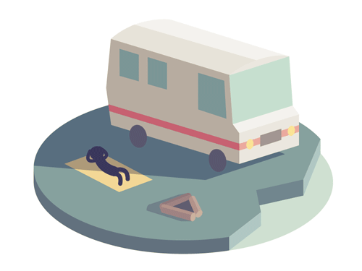
CSS3
Animations | Transitions
Animation properties
timing-function | ease, ease-out, ease-in, ease-in-out, linear, cubic-bezier(x1, y1, x2, y2) (e.g. cubic-bezier(0.5, 0.2, 0.3, 1.0))
duration & delay | Xs or Xms
duration-count | X
fill-mode | forwards, backwards, both, none
animation-direction | normal, alternate

Slide 24

CSS3
Animations | Transitions
Combine transitions and animations
@keyframes infinite-spinning {
from {
transform: rotate(0deg);
}
to {
transform: rotate(360deg);
}
}
.move {
animation: move 10s steps(10) infinite alternate;
}
DEMO

Slide 25
CSS3
Animations | Transitions
Similarities
From a distance, both animations and transitions are very similar. They both allow you to:
Specify which CSS properties to listen for changes on.
Set timing (easing) functions to alter the rate of going from a one property value to another.
Specify a duration to control how long the animation or transition will take.
Programmatically listen to animation and transition-specific events that you can then do with as you wish.
Visualize CSS property changes.
Beyond this point, though, you will see that animations and transitions diverge a bit and let their uniqueness shine through.

Slide 26
CSS3
Animations | Transitions
Differences
Animations and Transitions show their differences when it comes to how you trigger them to play, whether they loop easily, how complicated of a transition you can define, how formal you must be in being able to use them.
CSS3 transition is more simpler to use.
CSS3 animation gives more control to the developer on how the animation is performed. You can define what the state. should be at different stages of the animation, e.g, 0%, 10%, 30%, 50%....
CSS3 transition can only define the start and end state and the rest will be handled by the browser.
CSS3 animation can have iteration count which means how many times the animation will be repeated.
CSS3 transition will only perform the animation once. To repeat the animation with CSS3 transition, JavaScript may need to be used.
After each animation, the CSS3 animation will move back to its original state where before the animation starts While CSS3 transition will keep the animation state after each transition.

Slide 27
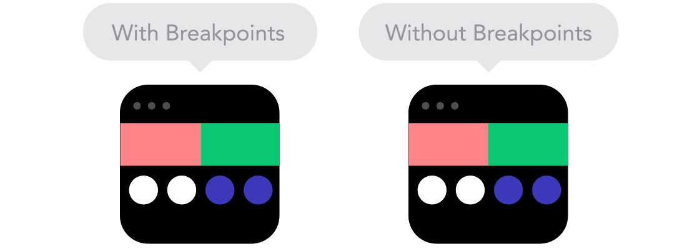
CSS3
Media Queries
A media query consists of a media type and at least one expression that limits the style sheets' scope by using media features, such as width, height, and color.

Slide 28
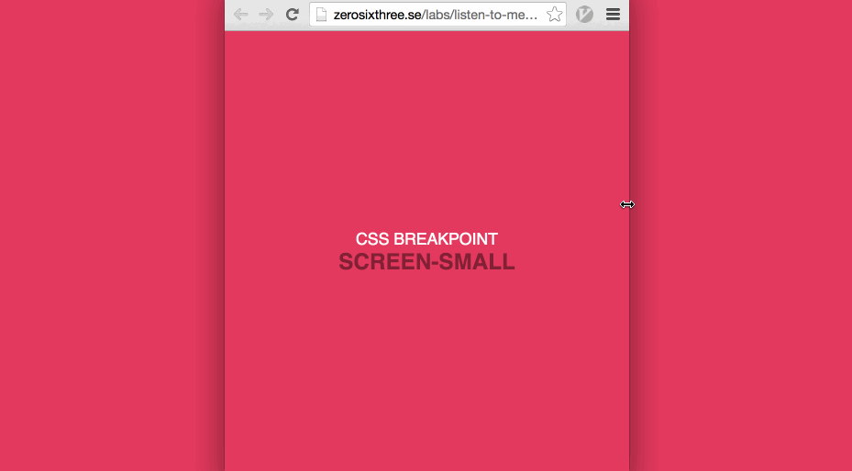
CSS3
Media Queries
Breakpoints allow the layout to change at predefined points, i.e. having 3 columns on a desktop, but only 1 column on a mobile device. Most CSS properties can be changed from one breakpoint to another. Usually where you put one depends on the content. If a sentence breaks, you might need to add a breakpoint. But use them with caution – it can get messy quickly when it's difficult to understand what is influencing what.

Slide 29
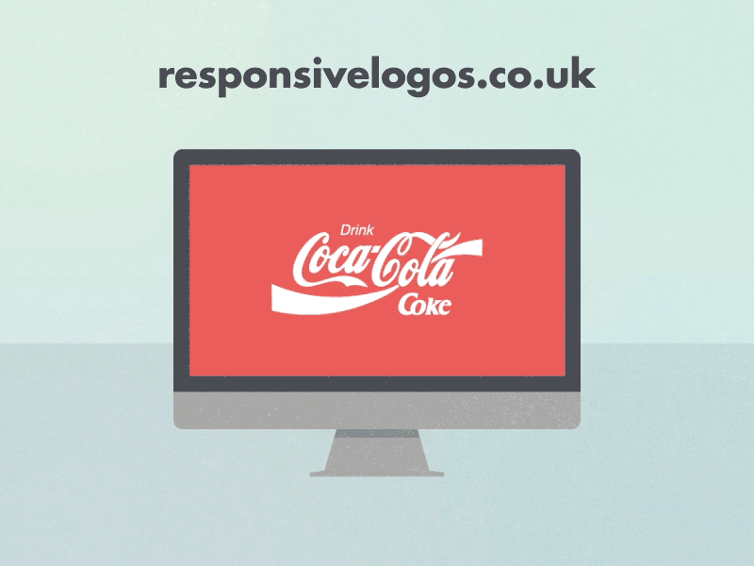
CSS3
Media Queries
/* Smartphones (portrait and landscape) ----------- */
@media only screen and (min-device-width : 320px) and (max-device-width : 480px) {
/* Styles */
}
/* Smartphones (landscape) ----------- */
@media only screen and (min-width : 321px) {
/* Styles */
}
/* Smartphones (portrait) ----------- */
@media only screen and (max-width : 320px) {
/* Styles */
}
DEMO

Slide 30
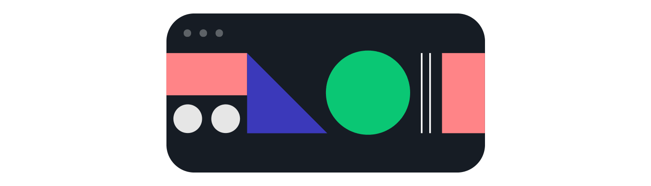
CSS3
Responsive | Adaptive
What is Responsive Web Design?
Responsive web design makes your web page look good on all devices.
Responsive web design uses only HTML and CSS.
It is called responsive web design when you use CSS and HTML to resize, hide, shrink, enlarge, or move the content to make it look good on any screen.
DEMO

Slide 31

CSS3
Responsive | Adaptive
Responsive Grid-View
Many web pages are based on a grid-view, which means that the page is divided into columns.
Using a grid-view is very helpful when designing web pages. It makes it easier to place elements on the page.
A responsive grid-view often has 12 columns, and has a total width of 100%, and will shrink and expand as you resize the browser window.

Slide 32

CSS3
Responsive | Adaptive
Adaptive
“Often uses a set of predefined layouts based on screen size, along with CSS and JavaScript, to deliver a user experience tailored to the device.”
by Sri Ramanathan of Kony

Slide 33
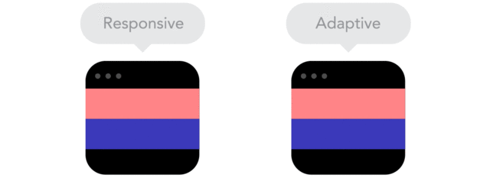
CSS3
Responsive | Adaptive
Responsive:
Offers a similar user experience but may take a little longer to load
It is less expensive
In terms of Search Engine Optimization, RWD gains as it deliver the same HTML code, no matter the device
Adaptive:
Provides an optimized website experience for each device
It is expensive
Load much faster because the design has the more efficient site rendering

Slide 34
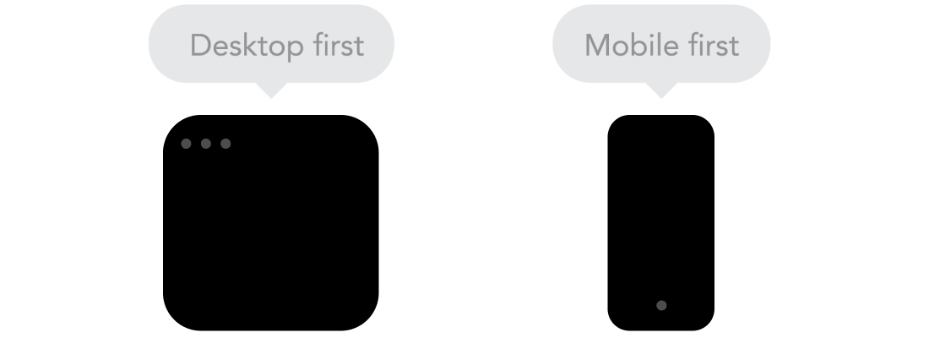
CSS3
Mobile or Desktop first
Technically there isn't much of a difference if a project is started from a smaller screen to a bigger (mobile first) or vice versa (desktop first). Yet it adds extra limitations and helps you make decisions if you start with mobile first. Often people start from both ends at once, so really, go and see what works better for you.

Slide 35
CSS3
Mobile or Desktop first
Why Mobile First?
The fact that mobile web access is popular does almost nothing to convince me that I need to pursue a strategy that actually puts mobile first. The flip side of 25% of mobile users being mobile-only is that 75% of them aren’t! Obviously, the desktop is still an important medium, not to be forgotten or pushed to the back burner quite yet. So why are we even considering taking the mobile first route?

Slide 36
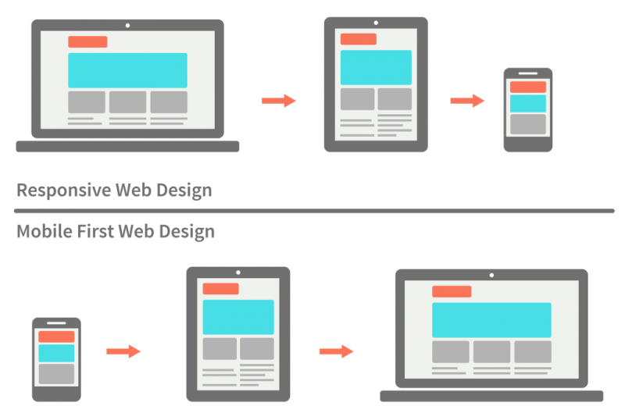
CSS3
Mobile or Desktop first
Graceful degradation | Progressive enhancement
Graceful degradation is the practice of building your web functionality so that it provides a certain level of user experience in more modern browsers, but it will also degrade gracefully to a lower level of user in experience in older browsers.
Progressive enhancement is similar, but it does things the other way round. You start by establishing a basic level of user experience that all browsers will be able to provide when rendering your web site, but you also build in more advanced functionality that will automatically be available to browsers that can use it.
Graceful degradation
Progressive enhancement

Slide 37


Slide 38


Alexandr Bolbocean
Iuliana Ciobanu
alexandr.bolbocean@endava.com
en_abolbocean
iuliana.ciobanu@endava.com
en_iuciobanu
<!DOCTYPE html>
<html>
<head>
<title>HTML & CSS</title>
</head>
<body>
<h1>THANK YOU FOR YOUR ATTENTION !</h1>
<p style=“color: red;”> Have a nice day!</p>
</body>
</html>

